Slide 1
Students_Marks_Prediction
In jupyter

Slide 2
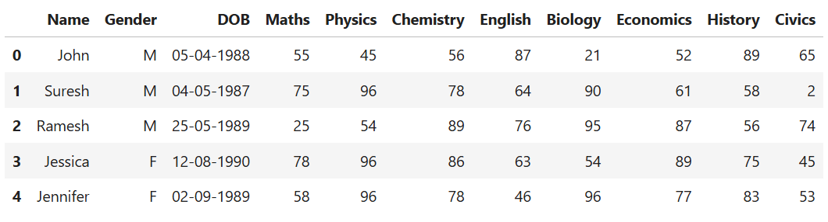
Jupyter Commands
1.) pd.read_csv()
CODE
import pandas as pd
df=pd.read_csv(r"D:\student_marks.csv")
df.head()
PURPOSE
This code is used to read a student marks dataset and preview its data.
OUTPUT

Slide 3
Jupyter Commands
2.) df.head()
CODE
import pandas as pd
df=pd.read_csv(r"D:\student_marks.csv")
df.head()
PURPOSE
Used to Show the Top Rows of the Dataset
OUTPUT

Slide 4

Jupyter Commands
3.) df.shape()
CODE
df.shape
PURPOSE
Used to display the number of rows and columns in a DataFrame.
OUTPUT

Slide 5

Jupyter Commands
4.) df.mean()
CODE
df.Maths.mean()
PURPOSE
Used to calculate the Average (mean) of numeric columns in the dataset.
OUTPUT

Slide 6
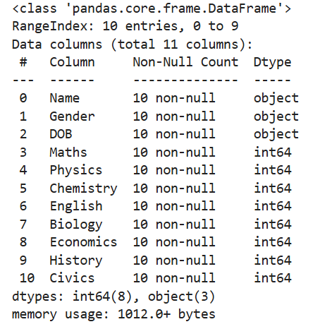
Jupyter Commands
5.) df.info()
CODE
df.info()
PURPOSE
Used to get complete information about your dataset.
OUTPUT

Slide 7
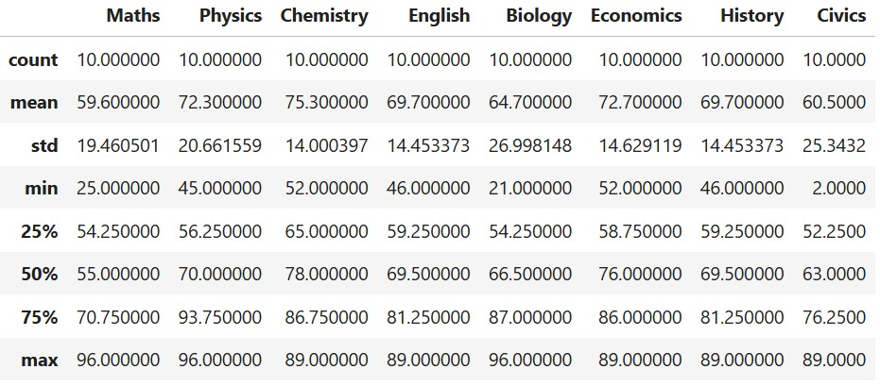
Jupyter Commands
6.) df.describe()
CODE
df.describe()
PURPOSE
Used to show the Statistical Summary of your dataset
OUTPUT

Slide 8
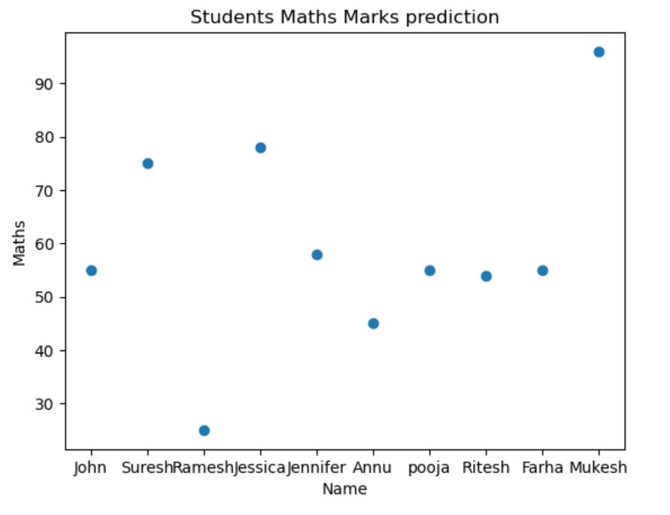
Jupyter Commands
7.) Scatter Plot Graph
CODE
PURPOSE
Used to show the relationship between two variables using dots (points).
plt.scatter(x=df.Name,y=df.Maths)
plt.xlabel("Name")
plt.ylabel("Maths")
plt.title("Students MathsMarksprediction")
plt.show()
OUTPUT

Slide 9

Jupyter Commands
8.) Mean
CODE
PURPOSE
Used to find the Average (mean) of the Maths marks column.
df.Maths.mean()
OUTPUT

Slide 10
Conclusions
There are various other Jupyter Commands such as:
1.) | df.isnull() | It is used to check which values in the dataset are missing (null/empty).
2.) | df.isnull().sum() | It is used to check missing (empty) values in each column of your dataset.
3.) | print("Shape of X_train=",x_train.shape) print("Shape of Y_train=",y_train.shape) print("Shape of X_test=",x_test.shape) print("Shape of Y_test=",y_test.shape) | It is used to check the size (shape) of training and testing data in Machine Learning.

Slide 11
THANK YOU

